Slide 1
PRESENTED BY
The Priests

Slide 2
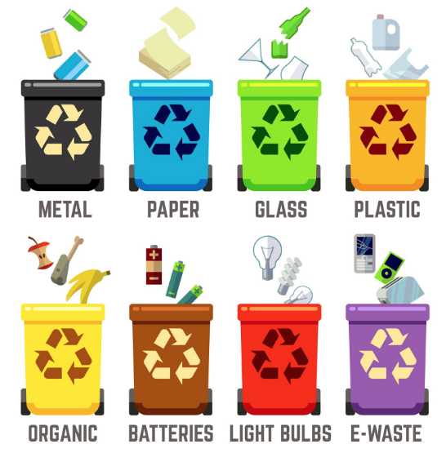
Waste Management System

Slide 3
What is waste management?

Slide 4
Waste management or waste disposal are all the activities and actions required to manage waste from its inception to its final disposal. This includes amongst other things collection, transport, treatment and disposal of waste together with monitoring and regulation.

Slide 5
Sounds complex right?

Slide 6

However, we can do all this just with a few clicks sitting in our homes
using My Waste Toolkit system. Just follow the given steps:

Slide 7
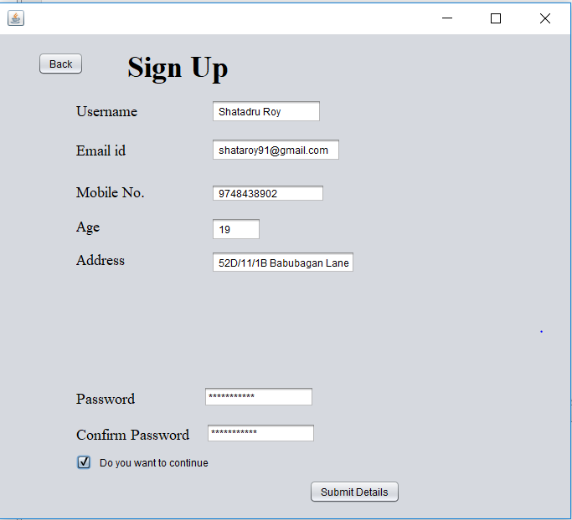
Step 1: sign up.

Slide 8
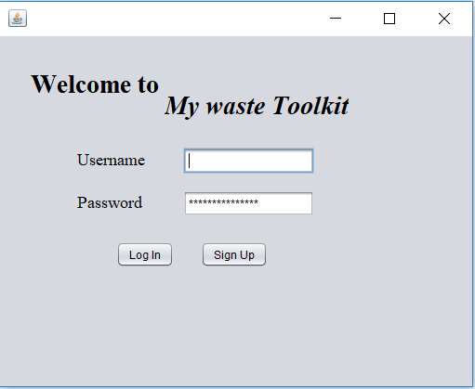
Step 2:LOgin

Slide 9
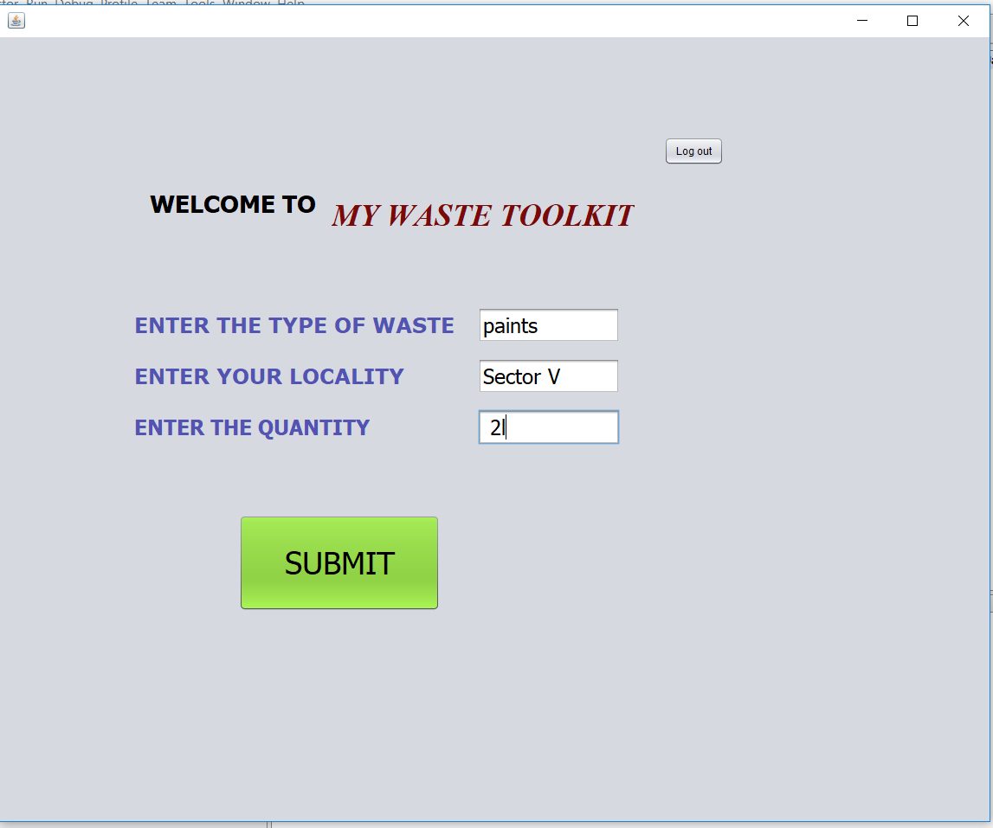
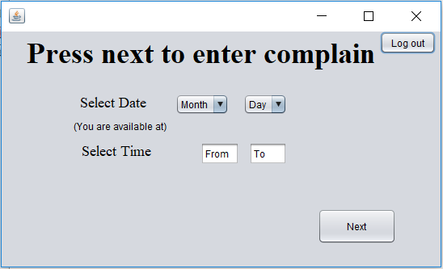
STEP 3: ENTER DETAILS

Slide 10
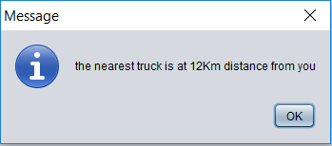
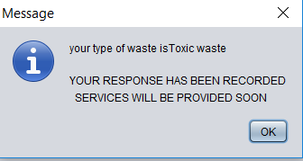
STEP 4:WAIT AND LET THEM DO THE WORK

